Slide 1


GOVERNMENT ENGINEERING COLLEGE, BHAVNAGAR
A PROJECT ON
Student Progress Analysis & Strategy
B.E. Sem-4
Information Technology
Submitted By,
Chavda Chirag 190210116013
Kukadiya Akhil 190210116033
Sonagara Sagar 190210116075
Kajaliya Charchil 170210116025
Project Guide,
Prof. Nishidh Chavda
HO.D. ,
Prof. V.G. Patel

Slide 2
INDEX
Introduction
Functionality
Canvases
Implementation Detail
Future Work
References
Conclusion
Suggestions

Slide 3
Title:- Student Progress Analysis & Strategy
Definition:-
Web app for student progress and analysis and strategy
. Introduction:
Our project name: Student Progress analysis and strategy
This project will improveing educational skill of student and helps to know the lavel of his/her progress.
It is use to determine the strategy of student and it is very easy for given marks and grad to student by faculty.
It will helping to parents for checking their child’s progress…

Slide 4
Functionality
Log in → HOD / COD / STUDENT
Verification
Based on SMS / Email
Validation
Department detail→
Result →
Mid exam
Semester exam
Certificate detail→
Upload by student
Given by college
Report card→
1. Semester wise report card
2. Department wise Avg. report card

Slide 5
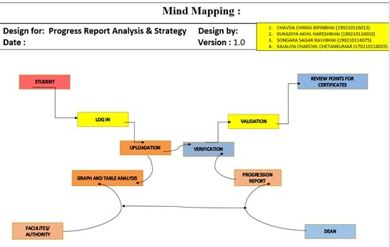
Mind Mapping Canvas

Slide 6
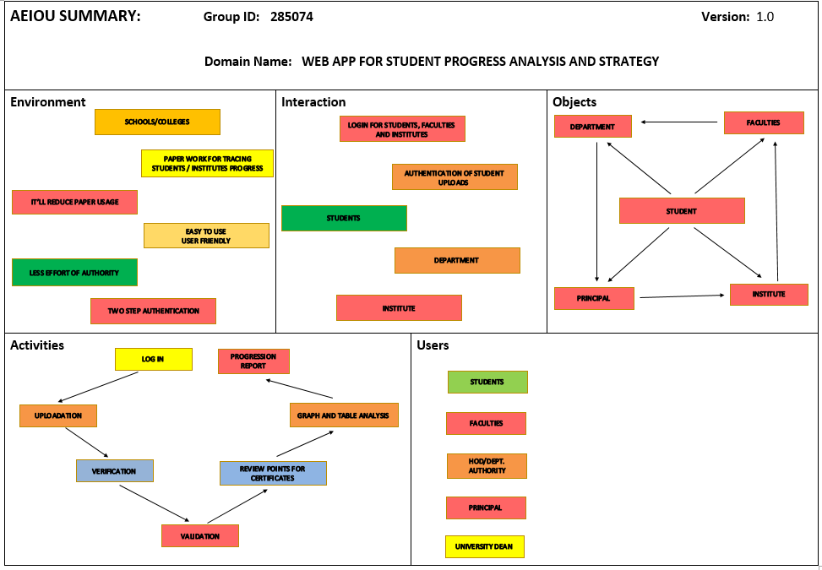
AEIOU Canvas

Slide 7
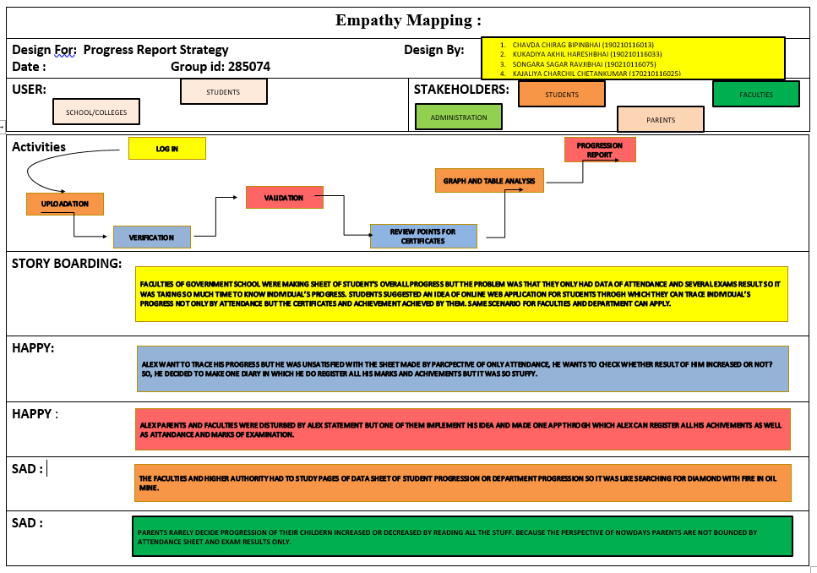
Empathy Mapping Canvas

Slide 8
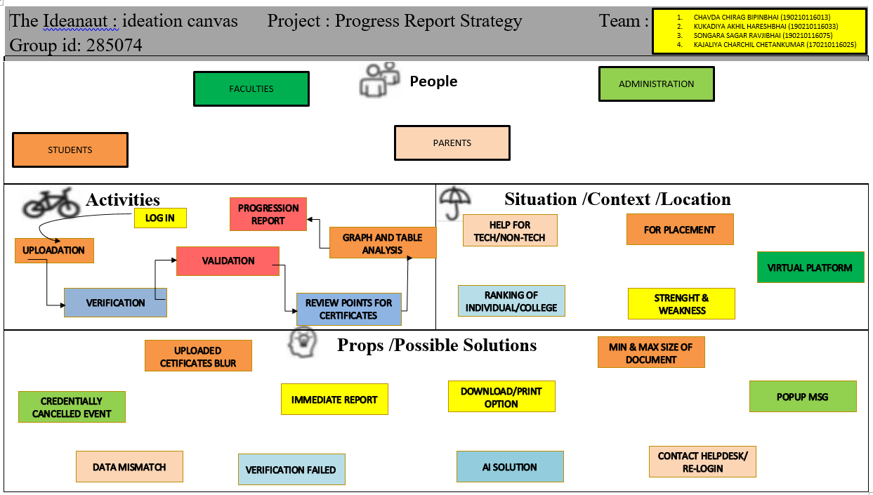
Ideation Canvas

Slide 9
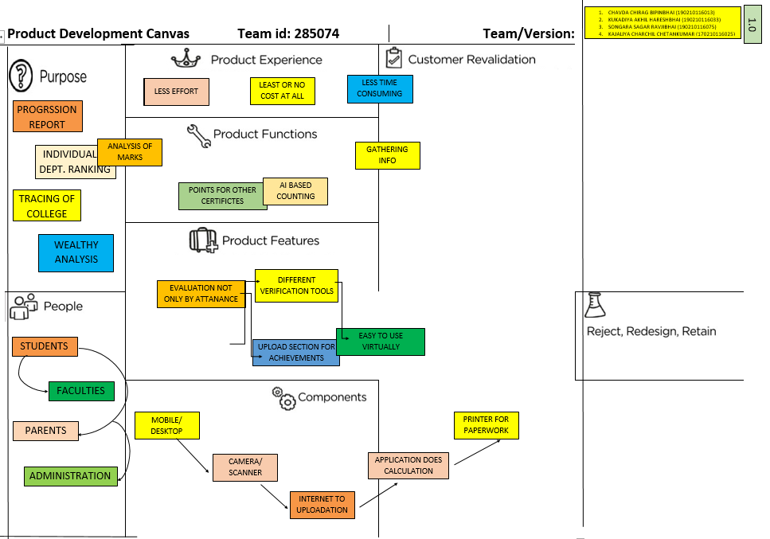
Product Development Canvas

Slide 10
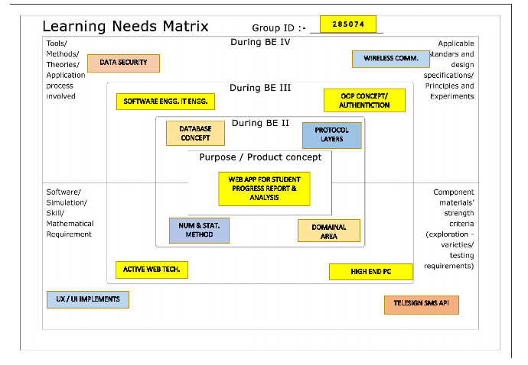
LNM (Learning Needs Matrix)

Slide 11
IMPLEMENTATION DETAILS
Target – To implement a Web Application for Students of their Progress.
WEB APPLICATION
FRONT END
BACK END
DATA BASE
HTML
CSS
BOOTSTRAP 4.x
React JS
Express JS
My SQL
* Tools/Technologies can be changed depending on Task.

Slide 12
Future Work
Two step verification for users.
This project will provide more features to students like upload assignments, attendance, reference books, question paper etc.
Project have a feedback section so we can update our project user friendly
This project have a comparison section, where student can compare their progress.

Slide 13
References
Links -
React-Js : https://reactjs.org/docs/getting-started.html
Node Js : https://nodejs.org/en/docs/
MySql : https://dev.mysql.com/doc/
My Sql Node Js - https://www.npmjs.com/package/mysql
Book –
JavaScript and JQuery: Interactive Front-End Web Development

Slide 14
Conclusion
By using this web app faculty or administers observe their students progress and they can easily make a strategy to improve it.
Parents can know their children’s attendances, marks or grad easily.
Student can compare their progress to another student.
By using this web app student can easily submit their work or project.
Faculty can give important notice through this web app easily.

Slide 15
If you have any suggestions about our project let us know

Slide 16
THANK YOU
ACADEMIC YEAR
2020-21

